Slide 1
Mehran S. Fallah June 2020
Programming Languages
Session IX
Lisp

Slide 2
Introduction
We have introduced the programming language Lisp and its good design features.
Dotted pairs were briefly introduced as the basic data structure of Lisp.
Basic and general programming functions were explained and used in some example programs.
In this session, we elaborate on the concept of cons cells (dotted pairs.) It is also explained how one may build a list using dotted pairs.
Programming with higher-order functions is also among the topics included in this session.
It is also explained why we say that Lisp is a garbage-collected language and why this could be a good feature of a language.
As stated earlier, Lisp has an impure part in the sense that one can write lisp programs whose execution results in side effects. We give some idioms of the language with side effects. It is also explained how one may write more efficient programs using the impure part of Lisp.

Slide 3
Cons Cells
Cons cells (or dotted pairs) are the basic data structure of the Lisp abstract machine. Cons cells have two parts, historically called the address part and the decrement part.
The letters a and d are seen in the acronyms car (for “contents of the address register”) and cdr (for “contents of the decrement register”).
We draw cons cells as follows:
We may represent an atom with a cons cell by putting a “tag” in the address part, which tells that the cell represents an atom, and the actual atom value in the decrement part. For example, the following represents the letter a.
Because putting a pointer in one or both parts of a cons cell represents lists, the bit pattern used to indicate an atom must be different from every pointer value.
There are five basic functions on cons cells: atom, eq, cons, car, and cdr.
The same functions cons, car, and cdr are present in Racket. The function eq is written eq? in Racket. Moreover, Racket has no function with the same functionality as atom.
car
cdr
atm
a

Slide 4
Cons Cells (Ctd.)
atom is a function with one argument: If a value is an atom, then the word storing the value has a special bit pattern in its address part that flags the value as being an atom. The atom function returns true if this pattern indicates that the function argument is an atom.
eq is a function with two arguments: compares two arguments for equality by checking to see if they are stored in the same location. This is meaningful for atoms as well as for cons cells because conceptually the Lisp compiler behaves as if each atom (including every number) is stored once in a unique location.
cons is a function with two arguments: The expression (cons x y) is evaluated as follows:
1. Allocate new cell c.
2. Set the address part of c to point to the value of x.
3. Set the decrement part of c to point to the value of y.
4. Return a pointer to c.
car is a function with one argument: If the argument is a cons cell c (i.e., a dotted pair), then return the contents of the address register of c. Otherwise, the application of car results in an error.
cdr is a function with one argument: If the argument is a cons cell c, then return the contents of the decrement register of c. Otherwise, the application of cdr results in an error.

Slide 5
Cons Cells (Ctd.)
In drawing cons cells, we draw the contents of a cell as a pointer to another cell unless the cell represents an atom.
We evaluate the expression (cons ’A ’B) by creating a new cons cell and then setting the car of this cell to point to the cell representing the atom ‘A and the cdr of the cell to point to ‘B. The expression ‘(A . B) would have the same effect, as this is the syntax for a dotted pair of atom A and atom B. Although this dotted-pair notation was a common part of early Lisp, Scheme and later Lisps emphasize lists over pairs.
What about the expression (cons (cons ‘A ‘B) (cons ‘A ‘B))?
atm
B
atm
A
A
B
A
B
‘((A . B) . (A . B))
A
B

Slide 6
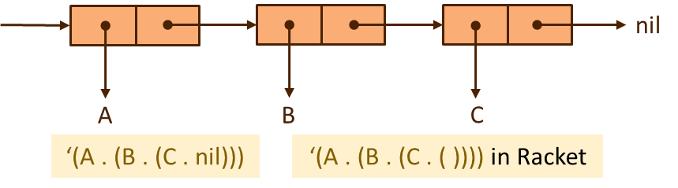
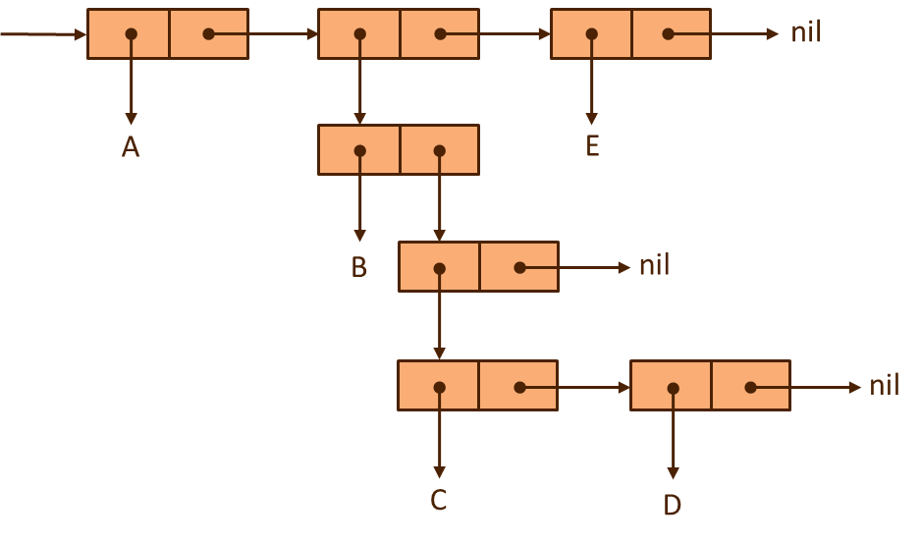
Cons Cells (Ctd.)
Because cons cells may contain two pointers, they may be used to construct trees. Lisp programs often use lists. Thus, there are conventions for representing lists as a certain form of trees. Specifically, the list a₁, a₂, …, a_{n} is represented by a cons cell whose car points to a₁ and whose cdr points to the cells representing the list a₂, …, a_{n}. For the empty list, we use nil (it is written ‘( ) or null in Racket). For example, here is the representation for the list (A B C).
Example 1. Draw the cons cells for (A (B (C D)) E).

Slide 7
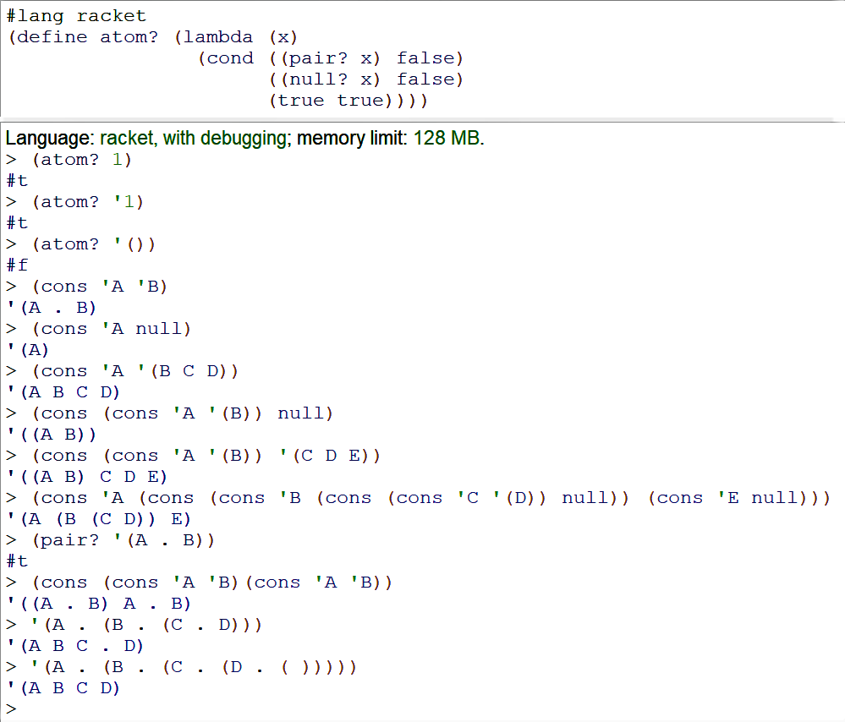
Cons Cells (Ctd.)

Slide 8
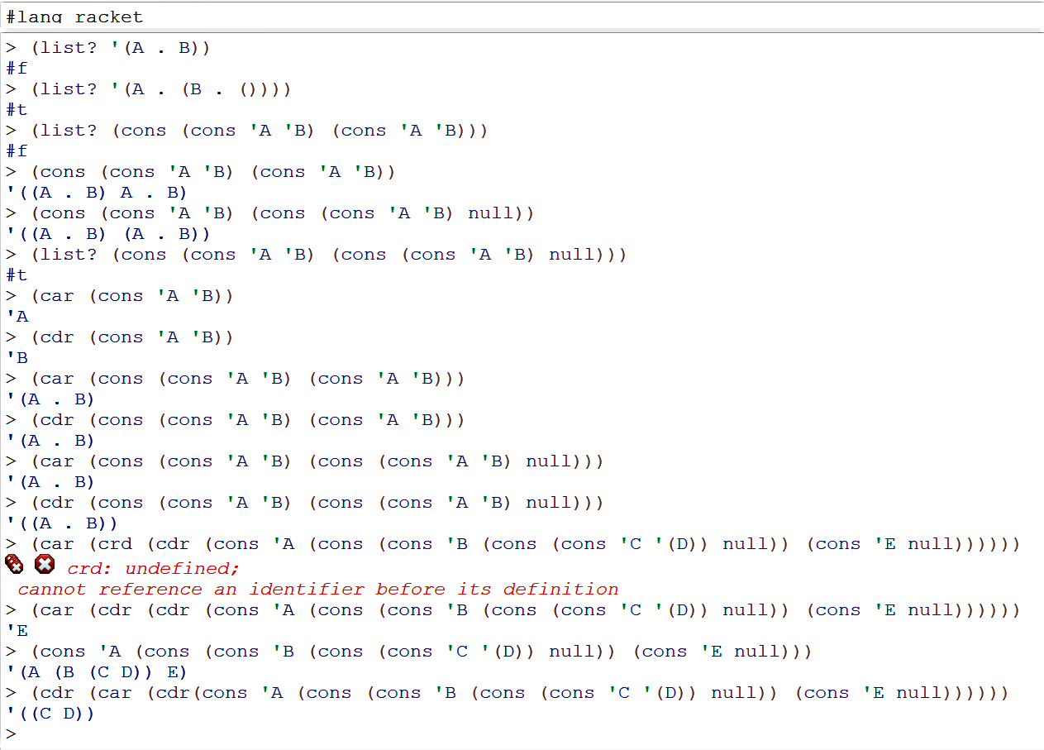
Cons Cells (Ctd.)

Slide 9
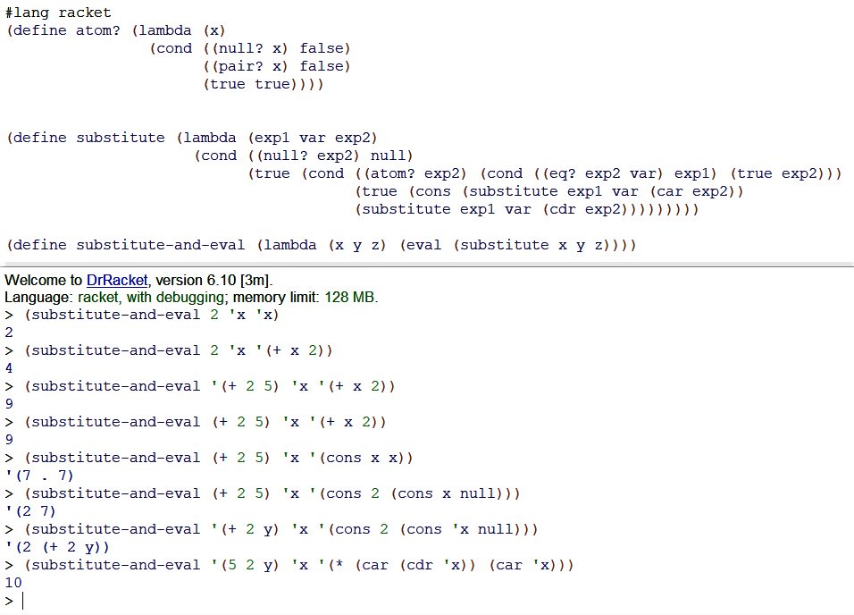
Programs as Data
Lisp data and Lisp programs have the same syntax and internal representation. This makes it easy to manipulate Lisp programs as data. One feature that sets Lisp apart from many other languages is that it is possible for a program to build a data structure that represents an expression and then evaluates the expression as if it were written as part of the program. This is done with the function eval.
Example 2. Write a Lisp function that substitutes expression x for all occurrences of y in expression z and then evaluates the resulting expression.
(define substitute (lambda (exp1 var exp2)
(cond ((atom exp2) (cond ((eq exp2 var) exp1) (true exp2)))
(true (cons (substitute exp1 var (car exp2))
(substitute exp1 var (cdr exp2)))))))
(define substitute-and-eval (lambda (x y z) (eval (substitute x y z))))

Slide 10
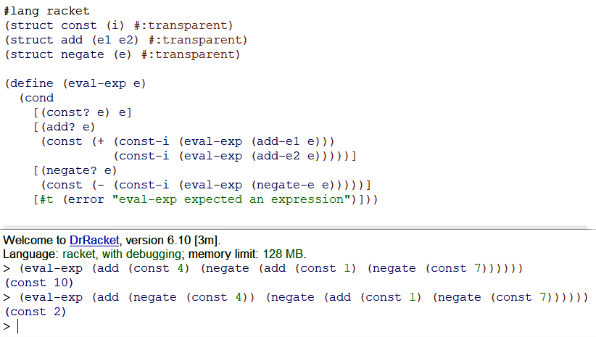
Programs as Data (Ctd.)
Example 3. The following is a simple interpreter for a language of arithmetic expressions with the idioms “const”, “add”, and “negate”.

Slide 11
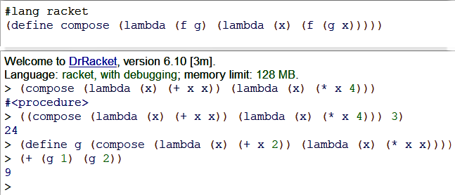

Higher-Order Functions
The phrase higher-order function means a function that either takes a function as an argument or returns a function as a result (or both). A function whose arguments and results are not functions is called a first-order function. A function that takes a first-order function as an argument is called a second-order function, functions on second-order functions are called third-order functions, and so on.
Example 4. If $f$ and $g$ are mathematical functions, say functions on the integers, then their composition $f∘g$is the function such that for every integer $x$, we have $(f∘g)(x)=f\left(g\left(x\right)\right)$. We can write composition as a Lisp function that takes two functions as arguments and returns their composition.

Slide 12
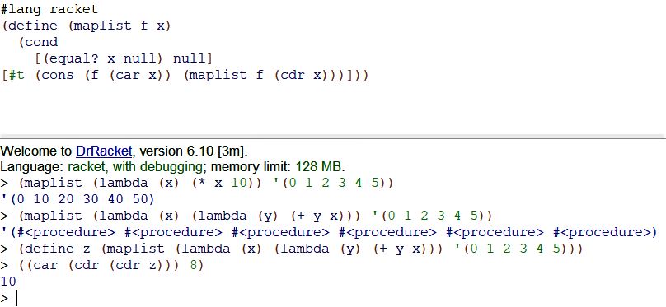
Higher-Order Functions (Ctd.)
Example 5. Write a function that takes a function and a list and applies the function to every element in the list. The result is a list that contains all the results of function application.
We cannot say whether the maplist is a second-order or third-order function, as the elements of the list might be atoms, functions, or higher-order functions.

Slide 13
Garbage Collection
In computing, garbage refers to memory locations that are not accessible to a program.
More specifically, we define garbage as follows:
This definition does not give an algorithm for finding garbage. However, if we could find all locations that are garbage, at some point in the suspended execution of a program, it would be safe to deallocate these locations or use them for some other purpose.
Garbage collection is the process of detecting garbage during the execution of a program and making it available for other uses. In garbage-collected languages, the run-time system receives requests for memory (as when Lisp cons cells are created) and allocates memory from some list of available space.
The list of available memory locations is called the free list. When the run-time system detects that the available space is below some threshold, the program may be suspended and the garbage collector invoked.
At a given point in the execution of a program P, a memory location m is garbage if no completed execution of P from this point can access location m. In other words, replacing the contents of m or making this location inaccessible to P cannot affect any further execution of the program.

Slide 14
Garbage Collection (Ctd.)
In Lisp, the memory locations that are accessible to a program are cons cells.
In Lisp and other garbage-collected languages, it is generally not necessary for the program to invoke the garbage collector explicitly.
In some modern implementations, the garbage collector may run in parallel with the program.
The idea and implementation of automatic garbage collection appear to have originated with Lisp. Here is an example of garbage. After the expression
(car (cons e₁ e₂ ))
is evaluated, any cons cells created by evaluation of e₂ will typically be garbage.
However, it is not always correct to deallocate the locations used in a list after applying car to the list. For example, consider the expression
((lambda (x) (car (cons x x))) ‘(A B)).
When this expression is evaluated, the function car will be applied to a cons cell whose “a” and “d” parts both point to the same list.

Slide 15
Garbage Collection (Ctd.)
Many algorithms for garbage collection have been developed over the years. Here is a simple example called mark-and-sweep.
Set all tag bits to 0.
Start from each location used directly in the program. Follow all links, changing the tag bit of each cell visited to 1.
Place all cells with tags still equal to 0 on the free list.
This algorithm assumes that we can tell which bit sequences in memory are pointers and which are atoms, and it also assumes that there is a tag bit in each location that can be switched to 0 or 1 without destroying the data in that location.
Garbage collection is a very useful feature. There is some debate about the efficiency of garbage-collected languages, however. Some researchers have experimental evidence showing that garbage collection adds of the order of 5% overhead to program execution time. On the other hand, explicit memory management (in C and C++, for example) can be cumbersome and error prone, so that for certain programs it is highly advantageous to have automatic garbage collection.
One phenomenon that indicates the importance and difficulty of memory management in C programs is the success of program analysis tools that are aimed specifically at detecting memory management errors.

Slide 16
Garbage Collection (Ctd.)
Example 6. In Lisp, we can write a function that takes a list lst and an entry x, returning the part of the list that follows x, if any. This function, which we call “select”, can be written as follows:
(define select (lambda (x lst)
(cond ((equal lst nil) nil)
((equal x (car lst)) (cdr lst))
(true (select x (cdr lst)))
)))
Here are two analogous C programs that have different effects on the list they are passed.

Slide 17
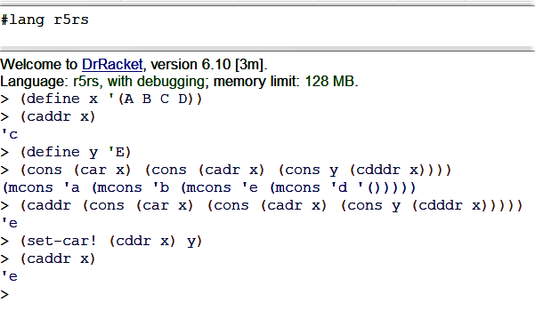
Impure Lisp
Pure Lisp expressions do not have side effects, which are visible changes in the state of the machine as the result of evaluating an expression. However, for efficiency, even early Lisp had expressions with side effects. Two historical functions with side effects are rplaca and rplacd:
(rplaca x y) − replace the address field of cons cell x with y,
(rplacd x y) − replace the decrement field of cons cell x with y.
In both cases, the value of the expression is the cell that has been modified. For example, the value of (rplaca (cons ‘A ‘B) ‘C) is the cons cell with car ‘C and cdr ‘B.
With these constructs, two occurrences of the same expression may have different values (this is really what side effect means.) For example, consider the expression (car x) in the following code:
(lambda (x) (cons (car x) (cons (rplaca x c) (car x)))) (cons a b)
Suppose we call the list (A B C D) x and we want to change the third element of x to y. In pure Lisp, we can only define a new list with elements A, B, y, D:
(cons (car x) (cons (cadr x) (cons y (cdddr x)))).
In impure Lisp we can change the third cell directly by using the expression
(rplaca (cddr x) y).

Slide 18
Concepts in Programming Languages (Chapter 3)
Please see Assignment 4 at https://courses.aut.ac.ir.

